Slide 1
SC-400T00A Microsoft Information Protection and Compliance Administrator
Author name

Slide 2
Implement Data Lifecycle and Records Management

Slide 3
Outline
Data Lifecycle Management in Microsoft Purview
Manage data retention in Microsoft 365
Implement records management in Microsoft 365

Slide 4
Data Lifecycle Management in Microsoft Purview

Slide 5
Agenda: Data Lifecycle Management in Microsoft Purview
List the customer scenarios the data lifecycle management solution addresses.
Explain what users will experience when the solution is implemented.
Articulate deployment and adoption best practices.

Slide 6
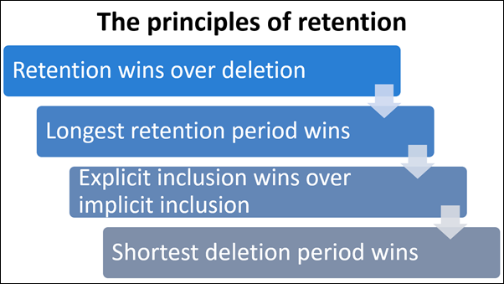
Data Lifecycle Management overview

Slide 7
Data Lifecycle Management overview (continued)
Retention Strategy
The goal of a retention strategy is to fulfill the requirements of laws, internal compliance policies and business regulations.
Creating a strategy includes several steps:
Know the data for an organization.
Know the requirements an organization must fulfill.
Create a retention plan.
Category | Examples
Personal data | Name, e-mail address, telephone number
Sensitive personal data | HR data, Health data, ethical origin, Union membership
Product data | Brand, pictures, tenders, product descriptions, internal IP
Authentication data | System generated data like username, MAC address, IP-address
Log files with system accesses | License data, log files, Telemetry, diagnostic data

Slide 8
Explain Retention Tools in Microsoft 365
Different tools to retain data:
To understand the right tools, know:
Retention Labels
Label Policies / Retention Label Policies
Auto-apply Retention labels
Retention Polices
Record Management
Retention Tags and Retention Policies
In-place eDiscovery & hold
eDiscovery
Where is the data stored today and in the future?
Which tools are used in the Microsoft 365 environment?
Which Retention requirements exist?
Which requirements does the Adoption Team have?
Are there other Systems like a DSM on SharePoint to retain and fulfill all requirements?
Which requirements do you want to fulfill in Microsoft 365
Notes:
This slide provided to be used at discretion of the instructor.
These slides allow the instructor to go deeper into the fundamentals of Information Governance if they desire.

Slide 9
Explain the Legal Hold to fulfill the requirements
Legal hold for retention requirements
Combination of location-based Retention with Retention Policies and Retention Labels required
Legal Hold used to preserve stored data for legal cases across the environment.
Requirements like SEC 17a4 (US) or GobD (Germany) need the use of regulatory records or a regular record to prevent a deletion and store files for a certain period.
Important to consider data of leaver and movers.
Recommendation for adoption: Keep it simple.
Notes:
This slide provided to be used at discretion of the instructor.
These slides allow the instructor to go deeper into the fundamentals of Information Governance if they desire.

Slide 10
Configure retention policies
Differences between retention policies and retention labels
Retention Policies are focused on service locations.
Retention Labels are focused on individual items.
Retention labels are created for certain kinds of business data.
Label policies are used to publish retention labels.
Type | Based on | Travel with the document | Data lifecycle | Examples
Retention Policy | Location, product | no | yes | Teams Chat, Junk Folder, SharePoint Site
Retention Label | Single file or email, library, or list | yes | yes, better | Email, document in a library

Slide 11
Configure retention labels
Retention period calculation
Retention label count starts when a label is applied.
Several legal and regulatory requirements start at the end of a year.
Exact requirements must be known to fulfil them with required accuracy.
A combination of retention labels and retention policies is required.
Document | Label | Method | Deletion | False
Invoice | 6 years + delete | Last modified on 1. May 2020 | Delete after 6 years in May 2026 | The file will be deleted 6 months too early.
Invoice | 7 years + delete | Last modified on 1. May 2020 | Delete after 7 years in May 2027 | The file will be deleted 5 months later. But it´s stored for the full time to fulfill the legal requirement.

Slide 12
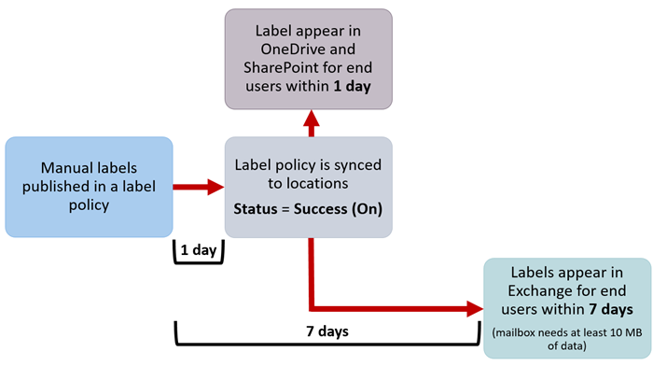
Configure manual retention label policies
Published labels will be available at the published location to be assigned manually
These locations include:
Exchange mail
SharePoint sites
OneDrive accounts
Microsoft 365 Groups
Exchange public folders, Skype for Business, Teams, and Yammer messages do not support retention labels.

Slide 13
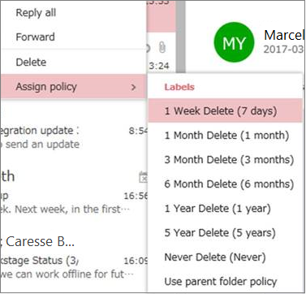
Configure manual retention label policies (continued)
Within Outlook a retention label can be assigned to an email through the assign policy ribbon
The retention label is then visible within the email
You can set the default retention label for an entire Outlook folder through the folder‘s properties
Within SharePoint you can set the retention label to a file through the file/folder/document libraries properties
Retention labels for OneDrive can be set through the web version through the file properties

Slide 14
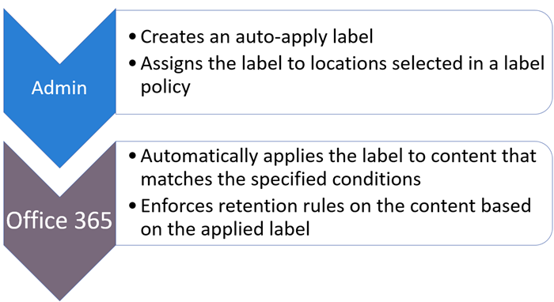
Configure auto-apply retention label policies
Auto-apply labels can apply retention labels automatically to:
Content that contains sensitive information that match sensitivity templates.
Content that contains specific words or phrases, or properties. This is specified by the Keyword query language.
Or trainable classifiers such as source code, offensive language or resumes.

Slide 15
Configure and manage adaptive scopes
Compared to static scope, the membership of adaptive scope is dynamic rather than static by querying selected attributes or properties for selected locations daily.
Adaptive scope is divided into three different types:
Users
SharePoint sites
Microsoft 365 Groups
Each type of scope uses different attributes or properties.
Adaptive scope type | Attributes or properties
Users | First Name, Last name, Display name, Job title, Department, Office, Street address, City, State or province, Postal code, Country or region, Email addresses, Alias, Exchange custom attributes: CustomAttribute1 – CustomAttribute15
SharePoint sites | Site URL, Site name, SharePoint custom properties: RefinableString00 – RefinableString99
Microsoft 365 Groups | Name, Display name, Description, Email addresses, Alias, Exchange custom attributes: CustomAttribute1 – CustomAttribute15

Slide 16
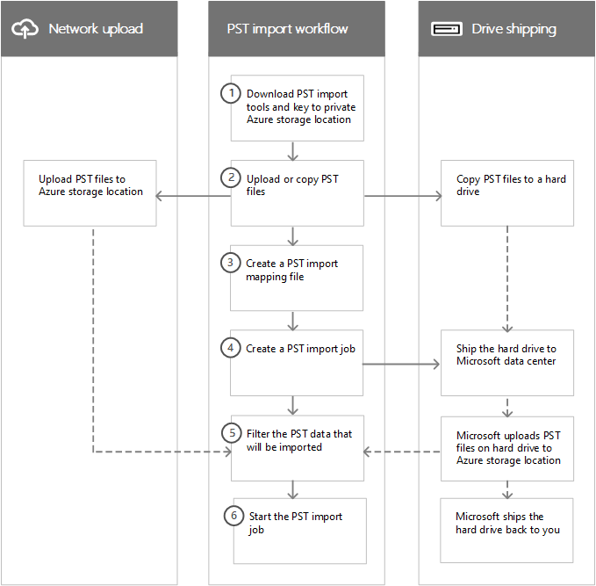
Import data for Data Lifecycle Management
There are two ways to import PST files to Office 365:
Network upload
Drive shipping

Slide 17
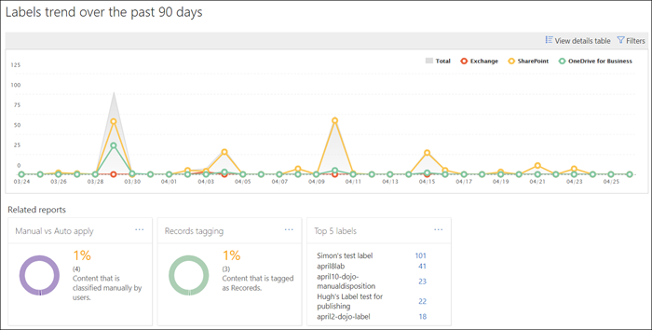
Manage and remediate Data Lifecycle Management
Data Lifecycle Management cards on the Data classification page:
Top sensitive info types
Top retention labels applied to content
Locations where retention labels are applied

Slide 18
Configure preservation locks
When a retention policy is locked:
When a retention label policy is locked:
No one can disable the policy or delete it
Locations can be added but not removed
You can extend the retention period but not decrease it
No one can disable the policy or delete it
Locations can be added but not removed
Labels can be added but not removed
To prevent accidentally locking a policy, use PowerShell configure a preservation lock.
Important: A preservation lock cannot be reversed. You will never be able to delete the locked policy again!

Slide 19
Manage data retention in Microsoft 365 workloads

Slide 20
Agenda: Manage data retention in Microsoft 365 workloads
Describe the retention features in Microsoft 365 workloads.
Configure retention settings in Microsoft Teams, Yammer, and SharePoint Online.
Recover content protected by retention settings.
Implement retention for Exchange Mailbox items.
Apply mailbox holds on Exchange Mailboxes.
Regain protected items from Exchange Mailboxes.

Slide 21
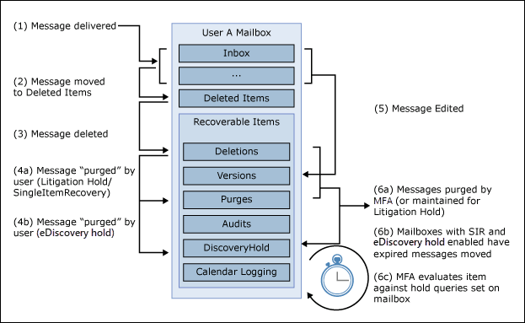
Explain retention in Exchange Online
Notes:
Hidden Recoverable Items Folders
Not visible for users in mailboxes.
Contains deleted mail messages and versions.
Processed by Managed Folder Assistant (MFA).
Access possible via
eDiscovery cases
Compliance Searches
Administrators must consider legal restrictions when accessing user mailboxes in some instances.

Slide 22
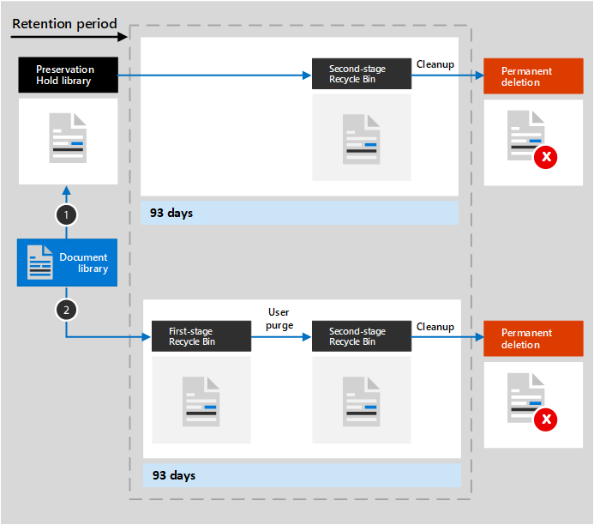
Explain retention in SharePoint Online and OneDrive
Notes:
Preservation Hold Library
Site specific document libraries
Used to preserve documents and versions
Can be accessed by administrators

Slide 23
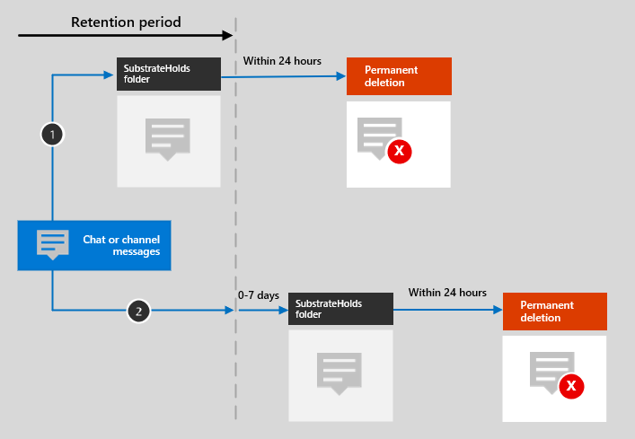
Explain retention in Microsoft Teams
Notes:
Azure Cosmos DB to SubstrateHolds
Compliance copy of data into mailboxes.
Hidden folder in folder structure.
Administrators must know storage locations to configure correct retention features.

Slide 24
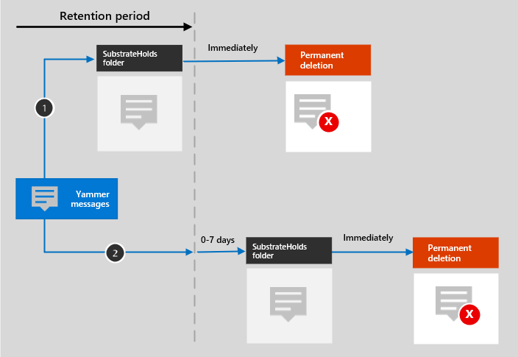
Explain retention in Microsoft Yammer
Notes:
Yammer messages are stored in a hidden folder in the mailbox of each user, whereas community messages are stored in a hidden folder in a group mailbox
A timer job from the Exchange service regularly evaluates items in this hidden folder, which can take up to seven days to run
When an item expires it´s retention period it is moved to the SubstrateHolds folder before they´re permanently deleted
Example When the retention policy is to retain and then delete
If a message is edited or deleted during the retention period it is copied (if edited) or moved (if deleted) to the SubstrateHolds folder where it is stored until the retention period expires.
If a message is not deleted, it is moved to the SubstrateHolds folder after the retention period expires. It is then deleted permanently

Slide 25
Recover content in Microsoft 365 workloads
Recovery options for users and administrators
Users can recover documents and files in OneDrive via their recycle bin.
Users can restore items on SharePoint Online document libraries via the recycle bin.
Users can restore versions in the SharePoint Online and OneDrive portal.
Users can restore versions via Office Online or via Microsoft 365 apps for enterprise.
Users can restore their entire OneDrive content.
Administrators can access the preservation hold libraries and recover data.

Slide 26
Activate archive mailboxes in Microsoft Exchange
Messaging records management (MRM)
Archive Mailboxes
Former feature for retention in Exchange
Used for archiving of mailbox content
Consists of different features:
Retention policies to publish retention tags to use.
Retention policy tags (RPTs) for default folders.
Default policy tags (DPTs) for all untagged items.
Personal tags for manual assignment.
Mailbox Folder Assistant (MFA) processes retention tag actions
Additional mailbox for archiving
Retention tags move items to archive

Slide 27
Apply mailbox holds in Microsoft Exchange
Mailbox Holds target Exchange Mailboxes
Protect content of Exchange mailboxes against deletion.
Two types of mailbox holds available:
Litigation Holds set on a mailbox level to protect all content from deletion.
eDiscovery Holds created in cases to prevent mailbox content matching search criteria from deletion.

Slide 28
Recover content in Microsoft Exchange
Exchange Mailbox content recovery with eDiscovery cases
Recovery of content from active and inactive mailboxes.
Results can be previewed and exported in .pst files.
Different eDiscovery permissions required for case creation, preview and export.

Slide 29
Manage records in Microsoft Purview

Slide 30
Agenda: Manage records in Microsoft Purview
Explain the records management solution and its benefits.
Describe the records management configuration process.
Explain what users will experience when the solution is implemented.
Articulate deployment and adoption best practices.

Slide 31
Records management overview
A record is a document or other electronic or physical entity in an organization that serves as evidence of an activity or transaction performed by the organization and requires retention for some time period.
Different actions that possibly needs to be prevented:
Change the assigned Retention Label of an item
Change of the content of an item or it’s metadata
Deletion of a file or remove a retention label from a file
Moving a file between containers (SharePoint libraries for example)
Four steps to plan and decide:
Decide to add a Record to a label or not
Decide to add a Record or a Regulatory Record to a label
Configure the Record to a label
Decide to have an auto labeling functionality and configure it
Notes:
Supporting videos for instructor or student use:
Demonstration – Records management
https://youtu.be/CAUDKL4FyQ8
(3 minutes)

Slide 32
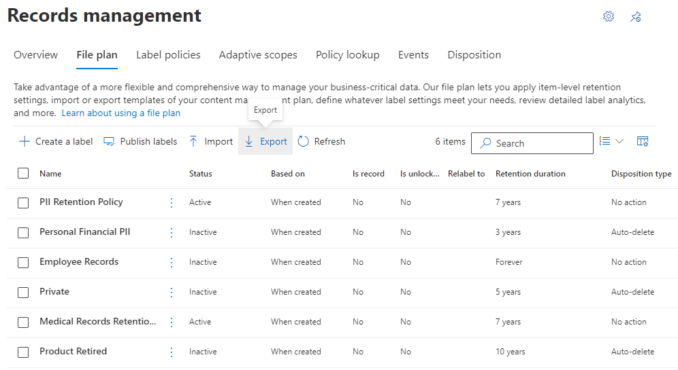
Import a file plan
File plans group the creation of labels, auto-apply label policies and additional metadata tags together
A file plan can help you manage how to dispose of files after the retention period
Export file plans as CSV-files and import them into other tenants
Use trainable classifiers to identify content it should match

Slide 33
Configure retention labels
Retention Labels used for Records Management.
Activation of records management via PowerShell required.
Different options available to configure retention labels after activation.
Option | Use to..
Without a Record | Does not add a record to a retention label.
With a Record | A simple record on a retention label restricts options for users to modify labeled items.
With a Regulatory Record | A regulatory record restricts options for users to modify labeled items more strictly. A warning will be displayed when a regulatory record is created and when the retention label will be applied to a file.

Slide 34
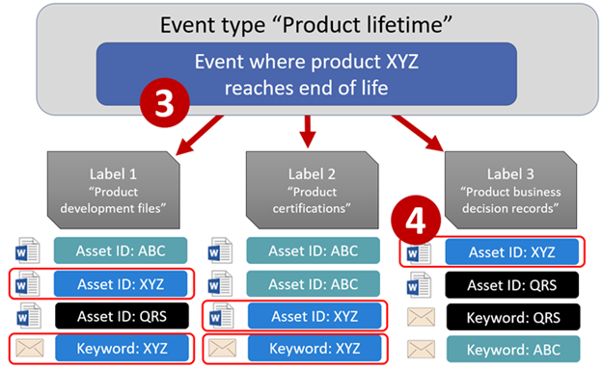
Configure event driven retention
Building blocks of event-driven retention
Event Types group up labels under one banner (e.g. Product lifetime).
Labels are added to content, but the retention period does not start immediately.
Asset IDs are unique to each product and have to be assigned by users.
Events can be triggered to start the retention period for all content containing the specified Asset IDs and the applied labels of the event type you selected.
Notes:
Supporting videos for instructor or student use:
Demonstration – Event driven retention
https://youtu.be/jSV2vKh0xNg
(13 minutes)

Slide 35
Configure event driven retention (continued)
1
Create labels and decide if you want your labels to mark records or even regulatory records
2
Use the file plan to publish your labels
3
Create event types specific to your retention strategy
4
Trigger events for your event types when your retention strategy calls for them

Slide 36
Knowledge check
1
Which of the following describes the most comprehensive approach to Data Lifecycle Management and its benefits?
Securing sensitive data and access
Ensuring your data is defensible and retrained.
A comprehensive approach across all content in your digital estate helps protect confidential information and prevent incidents that could disrupt your business.
2
Which of the following statements is accurate regarding retention labels?
Only one retention label can be assigned to content (such as an email or document) at a time.
Content like an email or document can have only a single retention label assigned to it at a time.
If content has an auto-apply label assigned, users can remove or change the retention label that is assigned.
3
Declaring content as a record means which of the following?
The item becomes immutable for a minimum amount of time.
The item becomes immutable until after the designated time period.
The item becomes immutable for a maximum amount of time.

Slide 37
Lab – Implement Data Lifecycle and Records Management

Slide 38
Lab Exercises
Exercise 1: Configure Retention Policies
Exercise 2: Implement Retention Labels
Exercise 3: Configure Service-based Retention
Exercise 4: Configure event-based Retention
Exercise 5: Use eDiscovery for Recovery
Exercise 6: Configure Records Management

Slide 39
Closing slide

